Slide 1
Introduction to
Artificial Intelligence
Lecture: Adversarial Search

Slide 2
Outline
Games
Optimal Decisions in Games
α-β Pruning
Imperfect, Real-time Decisions
Stochastic Games

Slide 3
Multiagent environments
Each agent needs to consider the actions of other agents and how they affect its own welfare.
The unpredictability of other agents introduce contingencies into the agent’s problem-solving process
Game theory views any multiagent environment as a game.
The impact of each agent on the others is “significant,” regardless of whether the agents are cooperative or competitive.
Types of games:
Perfect information vs Imperfect information
Deterministic vs Chance
A sequential game has perfect information if each player, when making any decision, is perfectly informed of all the events that have previously occurred, including the "initialization event" of the game.

Slide 4
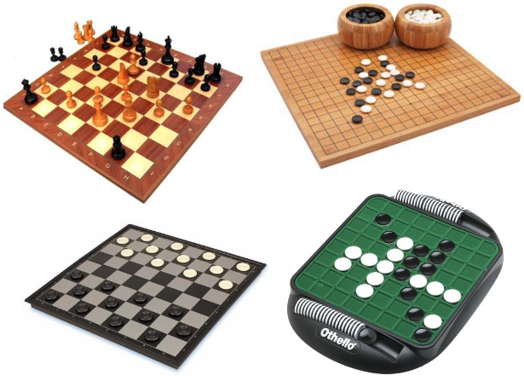
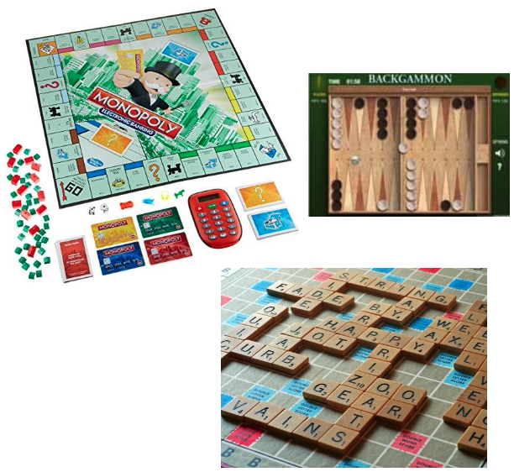
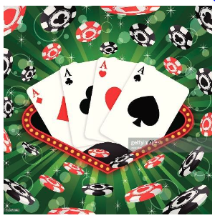
Types of game
 | Deterministic | Chance
Perfect information | Chess, Checkers, Go, Othello | Backgammon, Monopoly
Imperfect information |  | Bridge, poker, scrabble nuclear war

Slide 5
Adversarial search
Adversarial search (known as games) covers competitive environments in which the agents’ goals are in conflict.
Zero-sum games of perfect information
Deterministic, fully observable environments, turn-taking, two-player
The utility values at the end are always equal and opposite.

Slide 6
Primary assumptions
Two players only, called MAX and MIN.
MAX moves first, and then they take turns moving until the game ends
Winner gets reward, loser gets penalty.
Both players have complete knowledge of the game’s state
No element of chance
Zero-sum games
The total payoff to all players is the same for every game instance.
Rational players
Each player always tries to maximize his/her utility

Slide 7
Games as search
𝑆₀ – Initial state: How the game is set up at the start 0.
𝑃𝐿𝐴𝑌𝐸𝑅(𝑠): Which player has the move in a state, MAX/MIN?
𝐴𝐶𝑇𝐼𝑂𝑁𝑆(𝑠) – Successor function: A list of (move, state) pairs specifying legal moves.
𝑅𝐸𝑆𝑈𝐿𝑇(𝑠, 𝑎) – Transition model: Result of move 𝑎 on state 𝑠
𝑇𝐸𝑅𝑀𝐼𝑁𝐴𝐿 − 𝑇𝐸𝑆𝑇(𝑠): Is the game finished?
𝑈𝑇𝐼𝐿𝐼𝑇𝑌(𝑠,𝑝) – Utility function: A numerical value of a terminal state 𝑠 for a player 𝑝

Slide 8
Games vs. Search problems
Complexity: games are too hard to be solved
Time limits: make some decision even when calculating the optimal decision is infeasible
Efficiency: penalize inefficiency severely
Several interesting ideas on how to make the best possible use of time are spawn.

Slide 9
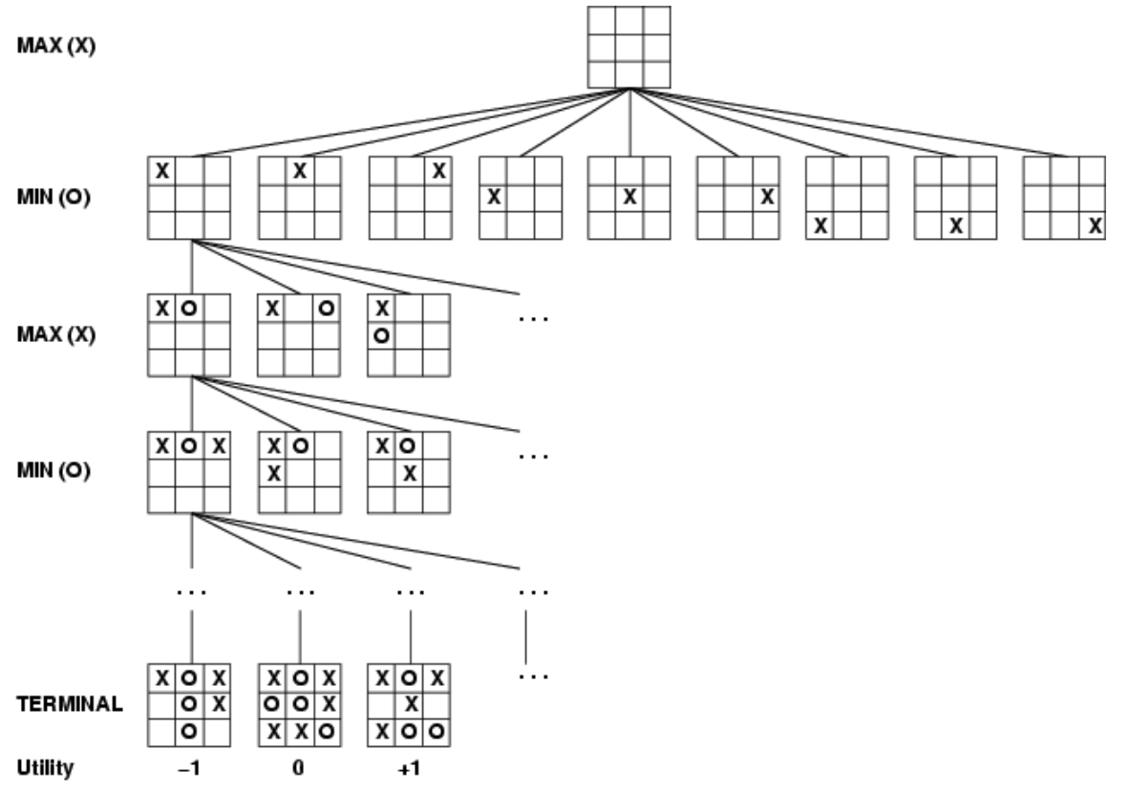
Search Tree of Tic-Tac-Toe

Slide 10
Optimal decision in games
Normal search problem
Optimal solution is a sequence of action leading to a goal state.
Games
A search path that guarantee win for a player
The optimal strategy can be determined from the minimax value of each node
MINIMAX(s) =
UTILITY(s) if TERMINAL-TEST(s)
max_{a∈Actions(s)}MINIMAX(RESULT(s, a)) if PLAYER(s) = MAX
min_{a∈Actions(s)}MINIMAX(RESULT(s, a)) if PLAYER(s) = MIN

Slide 11
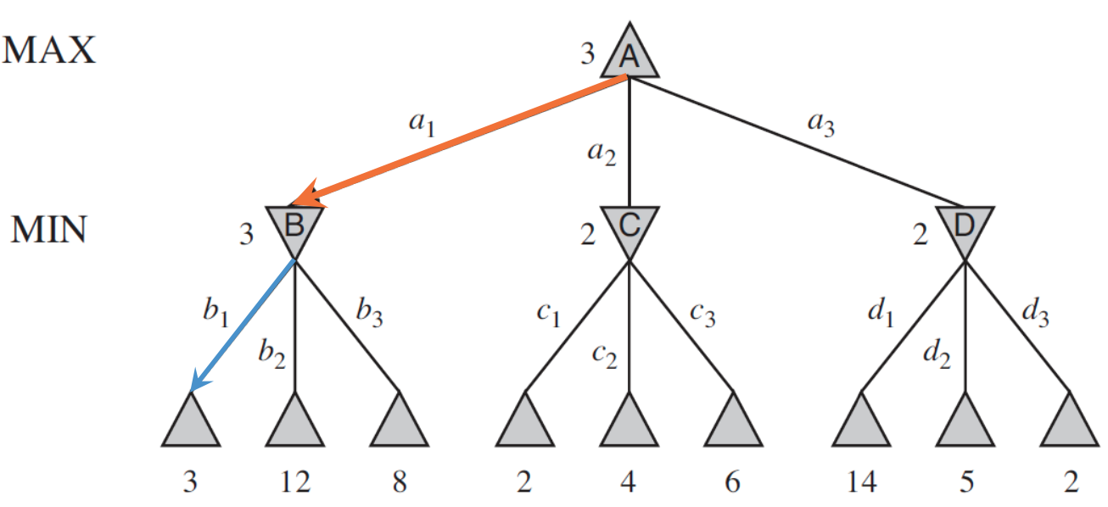
Example
MAX best move
MIN best move
Utility values for MAX

Slide 12
The minimax algorithm
Compute the minimax decision from the current state
Use a simple recursive computation of the minimax values of each successor state
The recursion proceeds all the way down to the leaves of the tree, and then the minimax values are backed up through the tree as the recursion unwinds.

Slide 13
The minimax algorithm
function MINIMAX-DECISION(state) returns an action
return argmax_{a ∈ ACTIONS(s)}MIN-VALUE(RESULT(state, a))
function MAX-VALUE(state) returns a utility value
if TERMINAL-TEST(state) then return UTILITY(state)
v ← -∞
for each a in ACTIONS(state) do
v ← MAX(v, MIN-VALUE(RESULT(s, a)))
return v
function MIN-VALUE(state) returns a utility value
if TERMINAL-TEST(state) then return UTILITY(state)
v←∞
for each a in ACTIONS(state) do
v ← MIN(v, MAX-VALUE(RESULT(s, a)))
return v

Slide 14
The minimax algorithm
A complete depth-first exploration of the game tree
Completeness
Yes (if tree is finite)
Optimality
Yes (against an optimal opponent)
Time complexity
𝑂(𝑏^{𝑚})
Space complexity
𝑂(𝑏𝑚) (depth-first exploration)

Slide 15
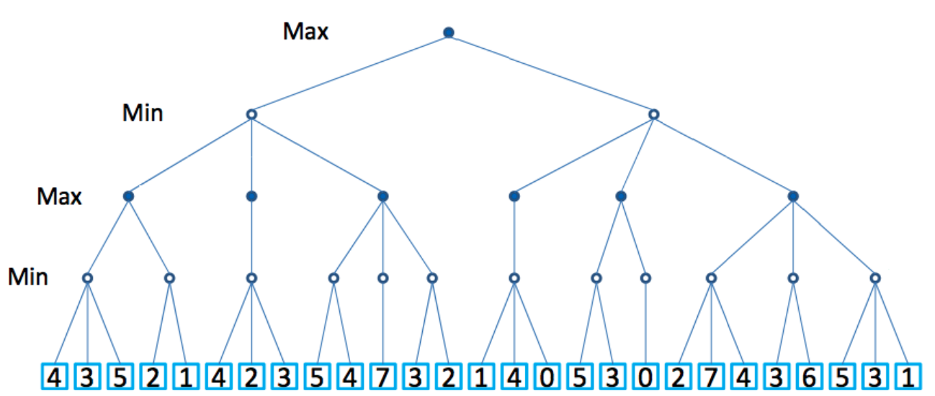
The minimax algorithm

Slide 16
Problem with minimax search
The number of game states is exponential in the tree’s depth
→ Do not examine every node
Alpha-beta pruning: Prune away branches that cannot possibly influence the final decision
Bounded lookahead
Limit depth for each search
This is what chess players do: look ahead for a few moves and see what looks best

Slide 17
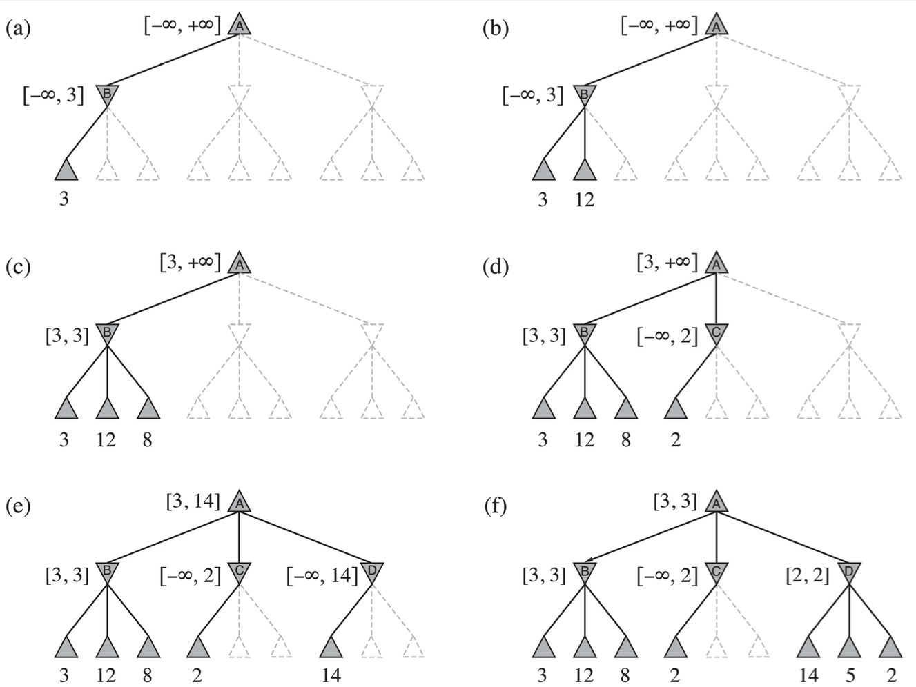
Alpha-beta pruning

Slide 18
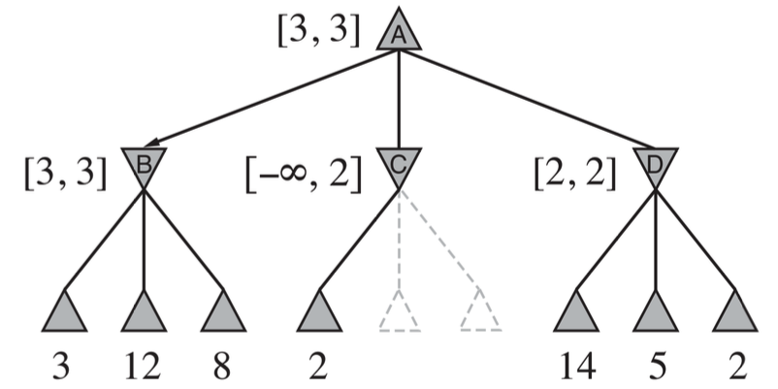
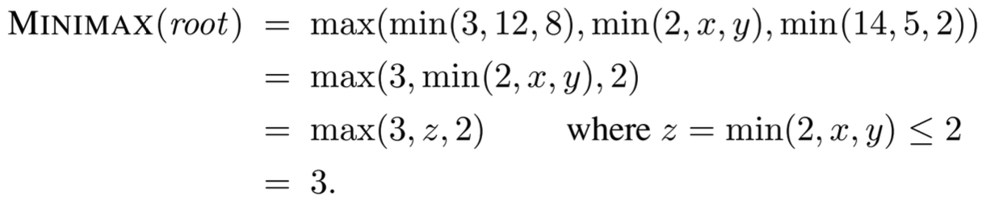
Alpha-beta pruning

Slide 19
Alpha-beta pruning
function ALPHA-BETA-SEARCH(state) returns an action
v ← MAX-VALUE(state,-∞,+∞)
return the action in ACTIONS(state) with value v
function MAX-VALUE(state,α,β) returns a utility value
if TERMINAL-TEST(state) then return UTILITY(state)
v ← -∞
for each a in ACTIONS(state) do
v ← MAX(v, MIN-VALUE(RESULT(s,a),α,β))
if v ≥ β then return v
α ← MAX(α, v)
return v
function MIN-VALUE(state,α,β) returns a utility value
if TERMINAL-TEST(state) then return UTILITY(state)
v ← +∞
for each a in ACTIONS(state) do
v ← MIN(v, MAX-VALUE(RESULT(s,a) ,α,β))
if v ≤ α then return v
β ← MIN(β, v)
return v

Slide 20
Alpha-beta pruning
Pruning does not affect the result
Good move ordering improves effectiveness of pruning
Killer move heuristic
Transposition table avoids re-evaluation a state

Slide 21
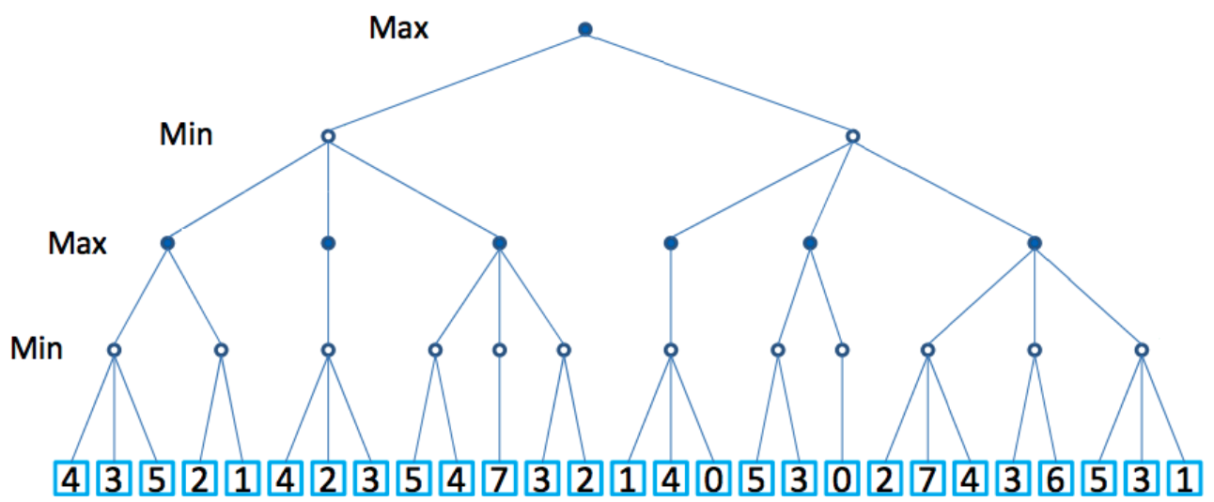
Alpha-beta pruning

Slide 22
Heuristic minimax
Both minimax and alpha-beta pruning search all the way to terminal states.
This depth is usually impractical because moves must be made in a reasonable amount of time (~ minutes).
Cut off the search earlier with some depth limit
Use an evaluation function
H-MINIMAX(s, d) =
EVAL(s) if CUTOFF-TEST(s, d)
max_{a∈ACTIONS(s)}H-MINIMAX(RESULT(s, a), d+1) if PLAYER(s) = MAX
min_{a∈ACTIONS(s)}H-MINIMAX(RESULT(s, a), d+1) if PLAYER(s) = MIN

Slide 23
Evaluation Functions
The evaluation function should order the terminal states in the same way as the true utility function does
States that are wins must evaluate better than draws, which in turn must be better than losses.
The computation must not take too long!
For nonterminal states, their orders should be strongly correlated with the actual chances of winning.

Slide 24
Cutting off search
Minimax Cutoff is identical to Minimax Value except
𝑇𝑒𝑟𝑚𝑖𝑛𝑎𝑙? is replaced by 𝐶𝑢𝑡𝑜𝑓𝑓?
𝑈𝑡𝑖𝑙𝑖𝑡𝑦 is replaced by 𝐸𝑣𝑎𝑙
if CUTOFF-TEST(state, depth) then return EVAL(state)

Slide 25
Stochastic Games
Uncertain outcomes controlled by chance, not an adversary!
Why wouldn’t we know what the result of an action will be?
Explicit randomness: rolling dice
Unpredictable opponents: the ghosts respond randomly
Actions can fail: when moving a robot, wheels might slip

Slide 26
Expectimax search
Values reflect average-case (expectimax) outcomes, not worst-case (minimax) outcomes
Expectimax search: compute the average score under optimal play
Max nodes as in minimax search
Chance nodes are like min nodes, but the outcome is uncertain
Calculate expected utilities, i.e. take weighted average of children
The underlying uncertain-result problems can be formulated as Markov Decision Processes

Slide 27
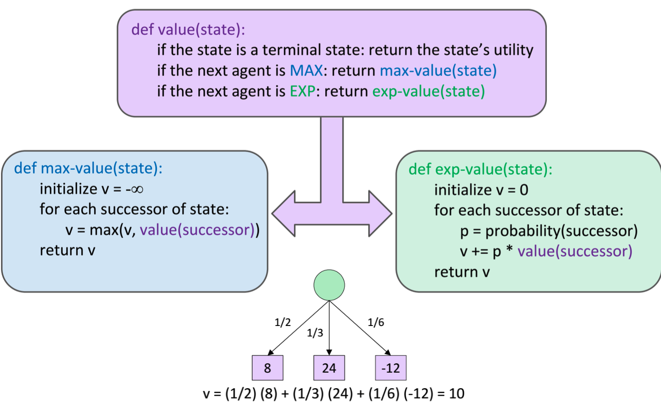
Expectimax search

Slide 28
Expectimax search
It is possible to perform pruning in expectimax search.
Common techniques for pruning in expectimax include:
Depth Limiting: Limiting the depth of the search tree can effectively prune branches that are too deep to be practically explored.
Evaluation Function: Using an evaluation function to estimate the value of a state without fully exploring its subtree. If the evaluation function indicates that further exploration is unlikely to yield significant improvements, you can prune the subtree.
Probabilistic Pruning: In scenarios where probabilities are involved, you might prune branches that have very low probabilities of occurring, as they contribute little to the overall expectation.
Iterative Deepening: Iterative deepening can be combined with pruning techniques to explore deeper parts of the tree only when necessary, based on the current state of the search.

Slide 29
References
Stuart Russell and Peter Norvig. 2009. Artificial Intelligence: A Modern Approach (3rd ed.). Prentice Hall Press, Upper Saddle River, NJ, USA.
Lê Hoài Bắc, Tô Hoài Việt. 2014. Giáo trình Cơ sở Trí tuệ nhân tạo. Khoa Công nghệ Thông tin. Trường ĐH Khoa học Tự nhiên, ĐHQG-HCM.
Nguyễn Ngọc Thảo, Nguyễn Hải Minh. 2020. Bài giảng Cơ sở Trí tuệ Nhân tạo. Khoa Công nghệ Thông tin. Trường ĐH Khoa học Tự nhiên, ĐHQG-HCM.

